Slide 1

Social Media Dashboard
This presentation covers a React-based interactive analytics dashboard component. It enables dynamic visualization of engagement, reach, and impression metrics across multiple time frames.

Slide 2
Meet the Contributors
Discover the talented team behind the Social Media Dashboard project. Each contributor brings unique expertise to deliver a powerful analytics tool.
Omar Mahmoud
Yahya Ayman
Reem Adel
Mohamed Galal
Front-End Developer
Also worked on some basic Back-End points
Front-End Developer
Worked on components and Styling
UI/UX Designer
Also Worked on the
Front-End
Front-End Dev
Worked on React components and Functions

Slide 3








Technology Stack
HTML/CSS
React.js
Bootstrap
Chart.js & Axios
Structure and style for responsive layout and design
Component-based UI for dynamic and interactive interfaces
Pre-built UI framework for consistent and mobile-first design
Data visualization and efficient API communication
Node.js
Express.js
MongoDB
React-Toastify
Server-side JavaScript runtime environment
Fast, unopinionated web framework for Node.js
NoSQL database for flexible, document-oriented data storage
Lightweight notification library for real-time user feedback
The dashboard combines these technologies to deliver a seamless user experience. React-Toastify adds smooth notification support for real-time feedback.

Slide 4
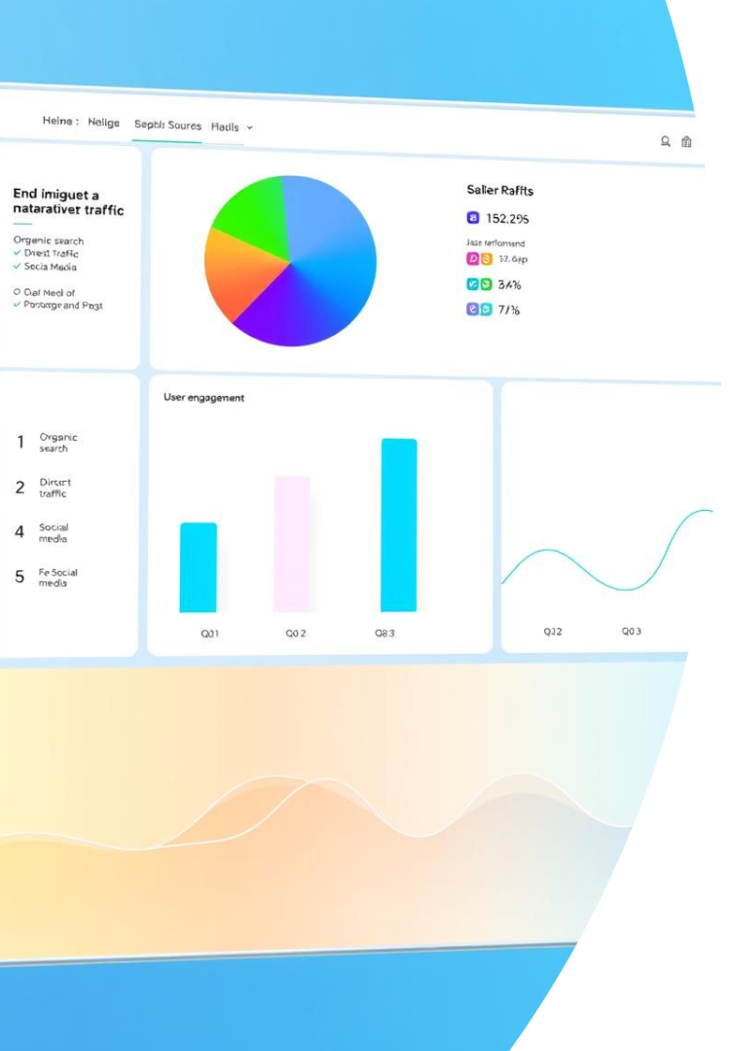
Dynamic Data Visualizations
Pie Chart
Bar Chart
Visualizes metric distribution with dynamic legends.
Shows trends with conditional highlighting on key points.
Line Chart
Illustrates growth patterns over extended periods.

Slide 5
Powerful Dynamic Filtering
Metric Selection
Time Range
Real-Time Updates
Choose from Engagement, Reach, or Impressions.
Options for Daily, Weekly, or Monthly data views.
Charts refresh immediately based on user filters.

Slide 6

Comprehensive Overview Section
Followers
Engagement Rate
Posts Published
Current user base with percentage change comparison.
Tracks how actively users interact with content.
Count of content items published during selected period.

Slide 7
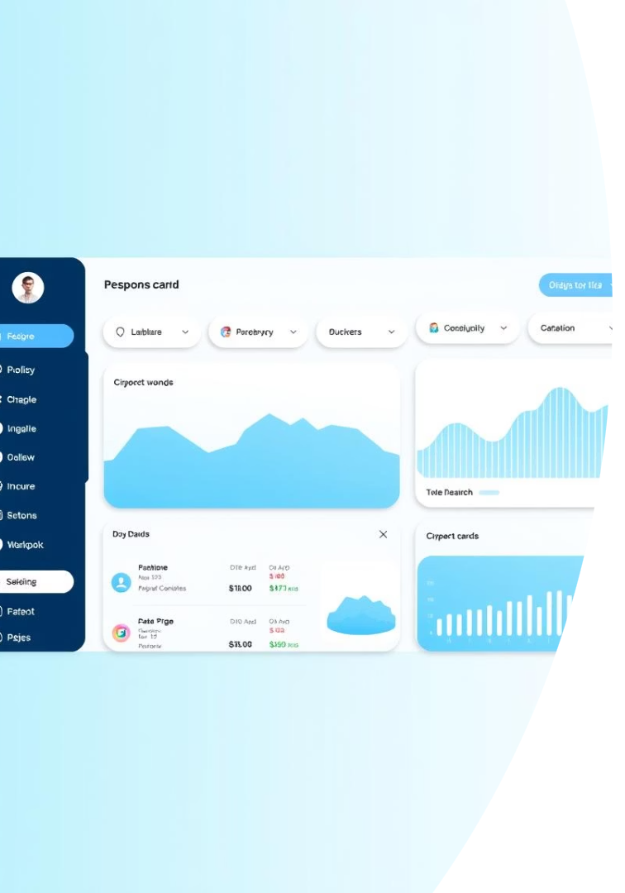
Modern UI/UX Design
Responsive Layout
Adapts seamlessly to different screen sizes.
Visual Consistency
Unified color palette elevates clarity and aesthetics.
Material Inspired Cards
Cards with rounded edges and shadows improve readability.

Slide 8
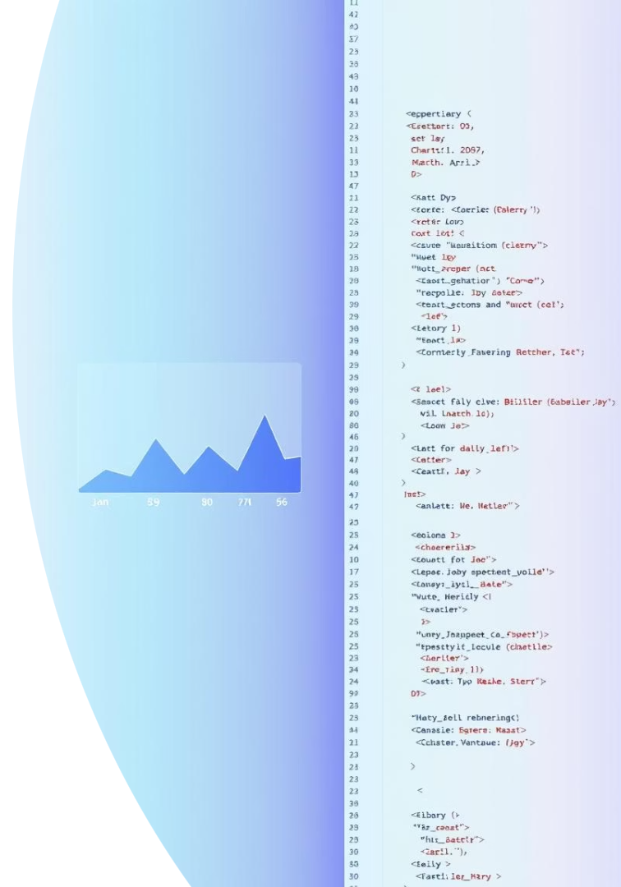



Reusable React Functional Component
Component Structure
Easy to integrate into larger React projects.
Leverages Chart.js
Robust charting with React wrapper for flexibility.
Customizable Props
Supports dynamic data and filter-based rendering.

Slide 9


Technology Stack
React
Chart.js
React Bootstrap
Frontend framework ensuring efficient UI rendering.
Powerful JavaScript library for flexible charting.
Prebuilt components enabling responsive, modern design.
JavaScript ES6+
Modern syntax supporting functional and modular code.

Slide 10

Key Takeaways and Next Steps
1
Dynamic Visualization
Interactive charts improve data understanding.
2
Scalable Component
Reusable in multiple application contexts.
3
Modern UI Design
Responsive and user-friendly interface boosts adoption.
4
Next Steps
Integrate component, collect feedback, and refine features.

